Slide 1
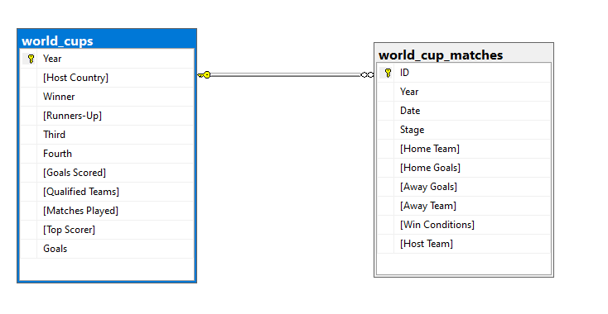
FIFA WORLD CUP Data set contain 2 tables
1- World_cups 2- World_cups_matches
In our FIFA World Cup database, a pivotal relationship has been established between the World_cups and World_cups_matches tables. The foundation of this relationship lies in the common key, the Year column. The World_cups table acts as the central repository for overarching World Cup event details, while the World_cups_matches table provides granular insights into individual matches.

Slide 2
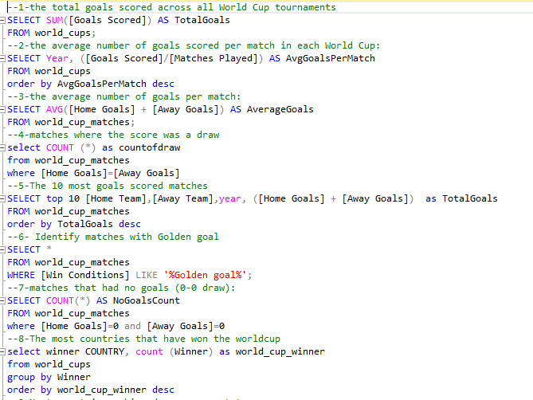
SQL queries used to answer specific questions related to FIFA World Cup data

Slide 3
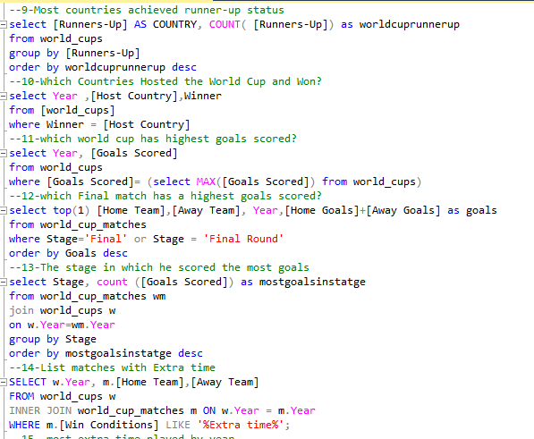
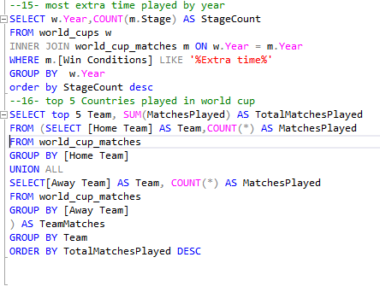

Slide 4
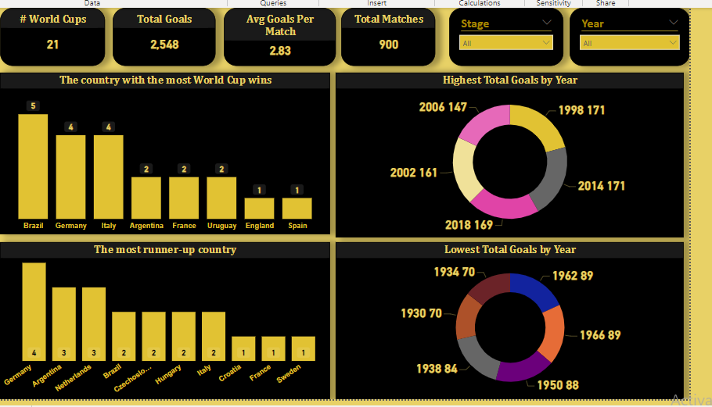
Dashboard by power bi

Slide 5
